Slide 1
REINSURANCE AND CO-GUARANTEES FOR AGRICULTURAL SECTOR IN ITALY
Giorgio Venceslai

Slide 2
ISMEA Role and Prerogatives
ISMEA is a public economic body supervised by the Ministry of Agriculture.
Acts as a statistical body and manages financial instruments for agriculture.
Has managed the main agricultural guarantee funds in Italy for years.

Slide 3
Evolution of Agricultural Guarantee Consortia
1990s: Confidi promoted by trade associations (CIA, Coldiretti, Confagricoltura).
Operated on mutualistic basis, regulated by the Consolidated Banking Act (TUB) of 1993.
2003 reform: stricter requirements, issues of capitalization and sustainability.
2010s: financial crisis, defaults, emergence of new structured consortia.

Slide 4
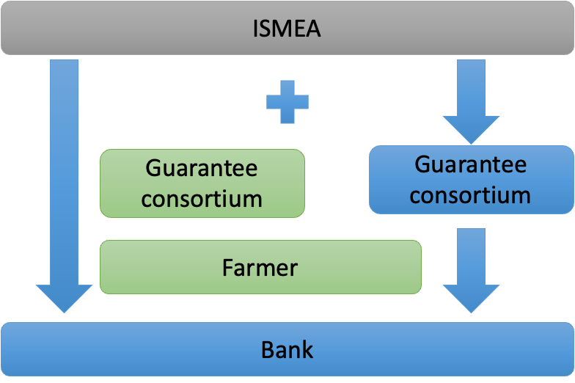
ISMEA Counter-Guarantee Mechanism
Based on Basel II principles.
First-level guarantor must comply with Basel II criteria.
Double default mechanism: protects bank if both debtor and guarantor default.
Allows banks to treat loans as state-backed, reducing capital requirements.
Pros: Powerful tool to extend State guarantee to agricultural SMEs.
Cons: Costly, requires first-level guarantee, reduces impact on loan.

Slide 5
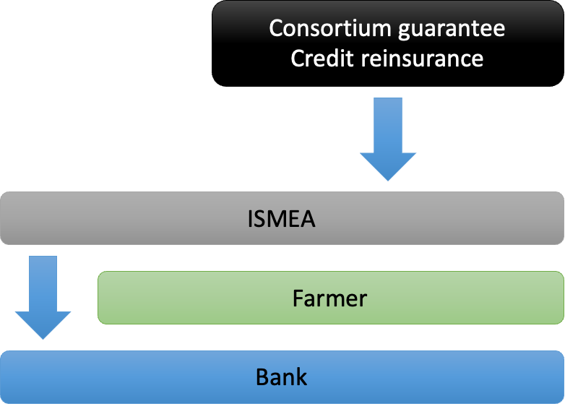
Counter-guarantee Alternative Model
ISMEA experimented with reversing guarantor roles.
ISMEA issues primary guarantee and consortium provides reinsurance.
Well received: allows Confidi to modulate commitment and recover from a share of the guarantee fee paid to ISMEA

Slide 6
Conclusion
ISMEA acts both as a direct and indirect guarantor.
Due to structural limits of Confidi, the counteguarantee in agricultural sector cannot be developed yet at an optimal level.
Better structured Consortia are growing and will be able to benefit of the traditional counter-guarantee model.
In the meanwhile, the ‘reverse’ counterguarantee model can be a way to commit the small-mid size Consortia to cooperate in the agricultural sector.

Slide 7
Thank you!

